Slide 1
Classification of Pneumonia and Covid-19 by using Deep learning
Name | ID
Md Sazid Ahmed Tonmoy | 1911498642
Mainuzzaman Mahin | 1812774042
Rufaida Islam | 1811153642

Slide 2
Background
The outbreak of the novel coronavirus disease or COVID-19 in December 2019 has led to a global crisis worldwide. World Health Organization (WHO) declared the situation a pandemic on the 11th of March 2020. Covid-19 has affected more than 200 countries, with more than 209 million confirmed cases and more than 4.38 million death tolls as of the 18th of August 2021. Reverse-transcription polymerase chain reaction (RT-PCR) is the standard method for the detection of COVID-19 disease. Still, it has many challenges such as false positives, low sensitivity, is expensive, and requires experts to conduct the test. As the number of cases continues to grow, there is a high need for developing a rapid screening method that is accurate, fast, and cheap. Chest X-ray (CXR) scan images can be considered an alternative or a confirmatory approach as they are quickly obtainable and easily accessible. Pneumonia, another disease caused by a virus similar to Covid-19. The severity of pneumonia can range from minor to life-threatening. This is particularly hazardous for kids, people aged over 65 years and those with health problems or immune systems that are affected. In this paper, we have classified covid-19 and pneumonia using deep transfer learning.

Slide 3
Problem Statement
RT-PCR is not so much accurate.
RT-PCR is time-consuming
Interaction with covid-19 patients when testing
Lack of RT-PCR testing kit
Painful process for patients
Difficulties in detecting patients who have either pneumonia or COVID

Slide 4
Objective
The primary object of the project is to achieve the highest accuracy rate for the prediction of the input images. This will guarantee that the output is credible and can be trusted. With the dataset being used, the primary goal is the accuracy rate. Different methods have been used to increase the accuracy, as explained further in the report.

Slide 5
Working Steps

Slide 6
Methodology
The dataset consisted of images of Pneumonia and covid patients' X-ray scans. For feature extraction, a CNN is utilized. Four conv2D layers, three Maxpooling2D layers, one flatten layer, two dense layers, and a relu activation function are included in the model. SoftMax, the final thick layer, serves as an activation function.
This research also uses transfer learning to compare the intended model accuracy to the pre-trained model accuracy. MobileNetV2 was used for pre-trained models, with minor tweaks in the final layers, and the ahead model was created from the basic model. Average Pooling, Flatten, Dense, and Dropout are the customized final layers. The CNN model is effective in extracting picture features. The model extracts the features of the given photos it then learns and differentiates the images based on these attributes.

Slide 7
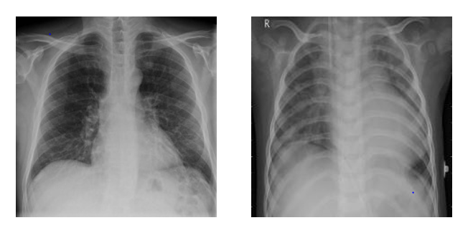
Data Description
The dataset used has two classes of images. One course consists of pictures of pneumonia patients, while another type holds the X-ray scan images of Covid-19 patients. The COVID patient's chest x-ray contains 1142 images, whereas the Pneumonia patient's chest x-ray has 4237 images. The dataset was divided into train and test sets for this study, with 70% of train data, 20% of validation data and 10% of test data.
On the right, an X-ray scan image of a pneumonia patient's chest is shown. On the left, we can see an X-ray scan image of the chest of a COVID-19 patient. Both X-rays have some abnormalities.

Slide 8
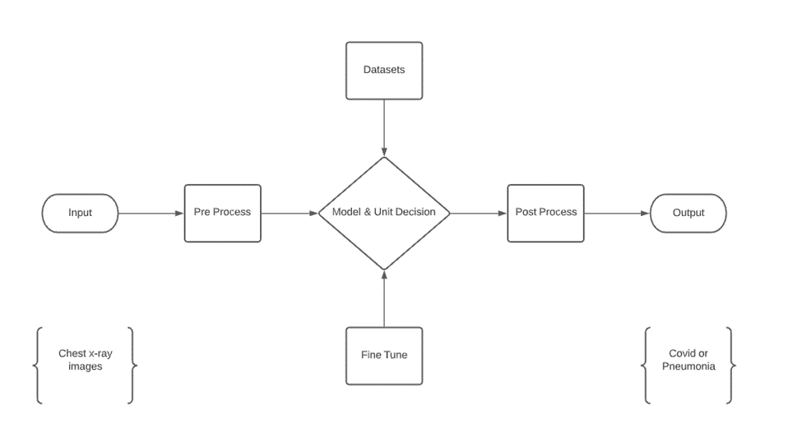
Block Diagrams
The input is divided into two subsections of the X-ray scan image used from the dataset. Pneumonia patients and the other are the Covid patients. The system is used to pre-process the data, such as loading the dataset of a particular size, splitting the dataset, and augmentation techniques. Much better accuracy is achieved due to the fitting and fine-tuning of the models. The change of the model loss and model accuracy over epoch is given by the plotting of the confusion matrix. The output section provides the result with; when the user inputs an image, the model can predict and provide the effect as an output if the given image is that of a Pneumonia patient or if the image is of a covid patient.

Slide 9
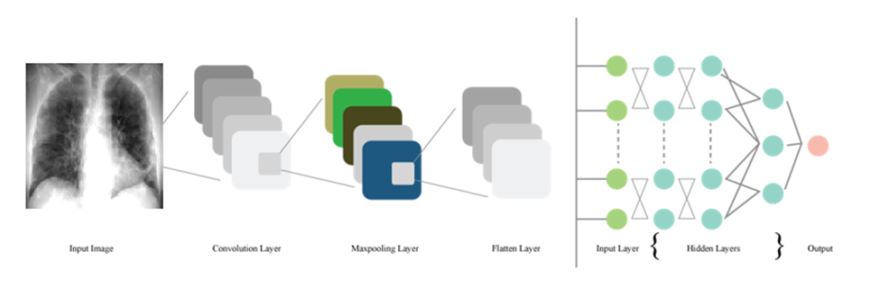
System Architecture
The system architecture gives an overview of the entire system being implemented. Here, the input is an X-ray scan image, and the output will be the prediction made by the model to predict if that input image is that of a pneumonia patient or a Covid-19 patient. The architecture is shown in the diagram below.

Slide 10

Convolutional Layer
This is the primary layer of CNN. The input image is passed through a filter. Values are then derived from the function map. It is responsible for deciding the characteristics.
Suppose the XX input is VRJK, with J indicating the number of features indicating an input frequency band and K indicating the cumulative set of input bandwidths. In the particular instance of filter bank attributes, K refers to the size of the filter bank function vector. Imply that v = [v1 v2... vK], with vK denoting the band b function vector. The activations of the convolution layer can be determined using the following equation::
where gd,e is the dth feature map’s convolution layer output of the convolution layer band of eth, s indicates the filter scale, wb,c indicates the weight vector for the dth filter’s bth band, ad is the cth feature map's bias, and (x) represents the activation function

Slide 11

Pooling Layer
This layer is responsible for easing down the sampling features by summarizing the presence of features. The application of the pooling layer is made after the convolution layer. The pooling layer removes redundant characteristics from photos and transforms them into readable images.
The use of a pooling layer helps to reduce the number of feature maps and network parameters. To avoid overfitting, a dropout layer is utilized. The activation of max-pooling is given by:
where ab,c is the performance of the pooling layer of the jth function map and the mth pooling layer band, n is the subsampling factor, r is the pooling scale which is the number of bands to be pooled together, and n is the subsampling factor.

Slide 12
Flatten Layer and Fully Connected Layer
•The Flatten layer converts data from the matrix into a one-dimensional array that may be used in the fully linked layer to create a single long, narrow, and one-dimensional feature. Vectors can be flattened if desired. Finally, it connects the single vector to the completely connected layer, also known as the final classification model.
CNN's rely heavily on fully connected layers, which have proven extremely useful in picture recognition and classification in computer vision. The CNN method begins with convolution and pooling, which splits the image into properties and examines them separately.

Slide 13
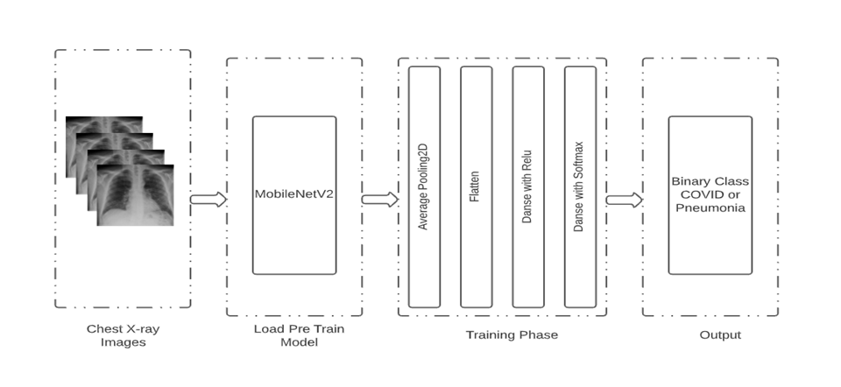
Pre-Trained Models
pre-trained models have been utilized to improve the accuracy of the predictions. MobileNet_V2 is the models. ImageNet data has also been used as a transfer learning method to work with inadequate data. The system architecture of the transfer learning technique is shown in side.
In the diagram, there are four distinct parts. The scans of the Chest x-ray are the first portion. The second step is to load a model that has already been trained. Three pre-trained models have been loaded in the second portion. The loaded pre-trained models were updated using the following layers in the third section, as illustrated in side.

Slide 14
Similar Systems
Automatic Detection of Coronavirus Disease (Covid-19) Using X-Ray Images and Deep Convolutional Neural Networks
Chest X-ray and computed tomography (CT) images are quite easy to obtain for patients. They are a low-cost procedure, making using them in recognition of COVID-19 applicable in most countries. Three different convolutional neural network models: ResNet50, InceptionV3, and Inception-ResNetV2, were used to detect coronavirus pneumonia in infected patients using chest X-ray radiographs. We required no feature extraction or selection phase. They achieved 87% accuracy for InceptionResNetV2. To avoid overfitting, they performed around 30 epochs in their training phase for all the models. However, they used a few images in their study, which were available for them to use at that time.

Slide 15
Similar Systems (Continue)
Detection of Coronavirus (Covid-19) Associated Pneumonia Based on Generative Adversarial Networks and a Fine-Tuned Deep Transfer Learning Model Using Chest X-Ray Dataset
It was using deep learning approaches instead of X-ray images, transverse section CT images for COVID-19 patients to detect the virus early. These images show different characteristics that can discriminate COVID-19 patients from other kinds of pneumonia, such as influenza-A. The samples were collected from three COVID-19 designated hospitals in Zhejiang Province, China, containing 618 CT samples: 224 from 224 patients with influenza-A viral pneumonia, 219 samples from 110 patients identified with COVID-19, and 175 samples from healthy people. These images were segmented into multiple candidate image cubes using two three-dimensional (3D) CNN models. The first CNN type was the traditional ResNet23. At the same time, the other was a designed model based on the first network structure by concatenating the location-attention mechanism in the full-connection layer to improve the overall accuracy, which reached 86.7%.

Slide 16
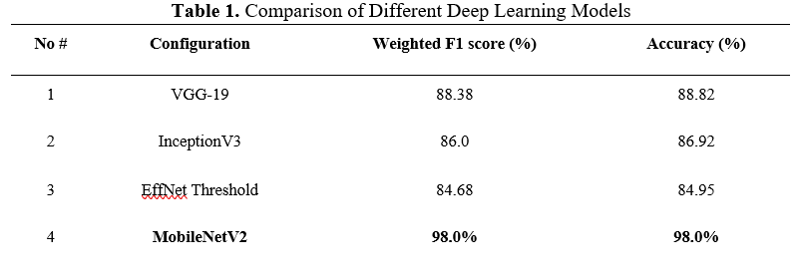
Result and Analysis
Several alternative network designs, such as VGG-19, inceptionV3, EfficientNet, and MobileNetV2, are tested before deciding on a network architecture. A bespoke 19-layer ConvNet is also tried, however the network does not function well. MobileNetV2 has outperformed all other networks, and the findings based on that design are included. Tab 1 displays the accuracy and loss of four tested models over time.

Slide 17
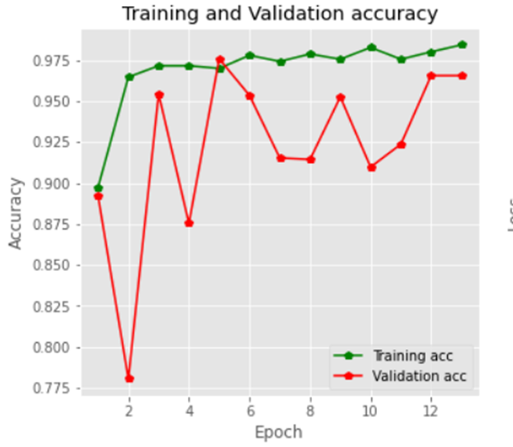
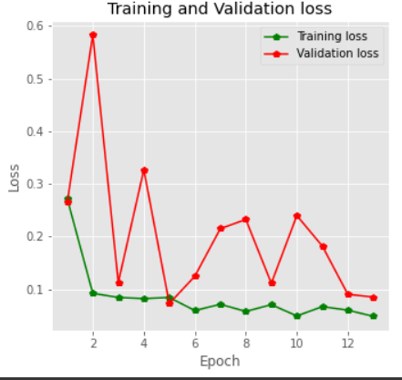
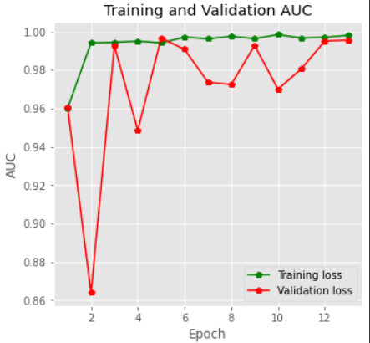
Model Accuracy
Everyone can observe that the train's accuracy is rapidly growing after each epoch if they look at the history of accuracy. The initial epoch's accuracy was 89.5 percent, then it improved with each subsequent epoch. The model's validation accuracy, on the other hand, was 89 percent and improved until the last epoch. A rising line was created for the train's correctness and for the test accuracy of around 91 percent -96 percent throughout this era, as seen on the plot of model accuracy.

Slide 18
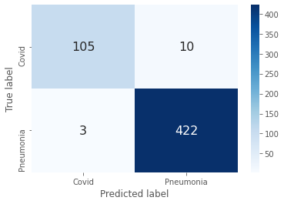
Model Accuracy (Cont.)
The confusion matrix of the system is displayed, with real values in columns and rows of anticipated values. The summary of the outcomes of the prediction is called the confusion matrix in a classification model. Correct and inaccurate predictions in the confusion matrix are summarized and classified. Fig. is displayed beside for the confusion matrix.

Slide 19
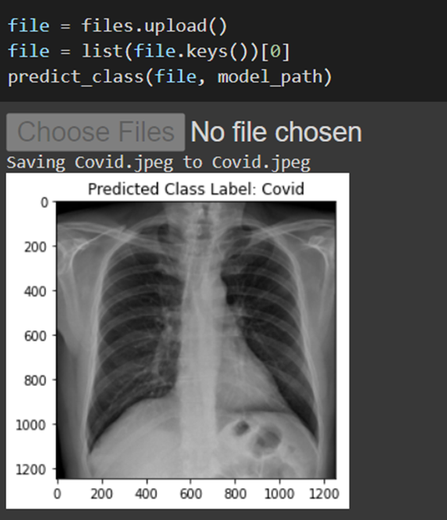
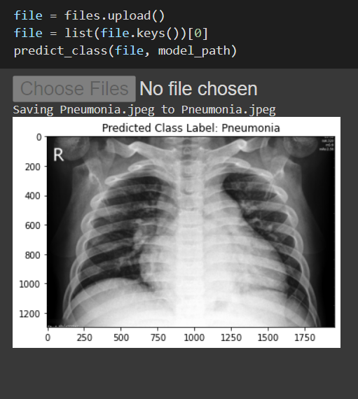
ModeL Test
The model was also subjected to real-world testing by using chest x-ray pictures as input. When the model is complete, a file with the hdf5 extension is generated, which contains the real model. Four hdf5 files for four distinct types of models were produced for this investigation. After that, a new notebook file with the ipynb extension is produced for the test. Four models were included in the test file, and individual chest x-ray pictures were given as input. The results of the test are presented in Fig below, along with a prognosis of whether it is Covid or Pneumonia.

Slide 20
Conclusion
In this publication, MobileNetV2 is pre-trained and adjusted in the final layers. Models in this category and the correctness of the paper was nearly identical. There are 1142 Covid and 4237 pneumonia chest x-ray pictures in the collection. The pre-trained model has a 98 percent accuracy rate, while the customized deep transfer learning model has a 97 percent accuracy rate. Research on a larger dataset and with additional pre-trained models will be conducted in the future. In regards to our dataset, these models have shown excellent outcomes. With these datasets, MobileNetV2 has done exceptionally well.
This breakthrough will have a significant impact on the medical field. Covid-19 and pneumonia patients can easily determine which factors can be attributed to the current global epidemic situation using this method. A chest X-ray is comparable to collecting samples from the patient's nose in terms of safety.

Slide 21
Thank You….

